Slide 1
Dual-slope ADC

Slide 2
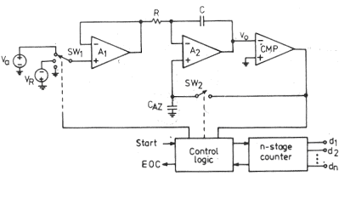
Dual-slope ADC
The circuit consists of a high input impedance buffer A₁, precision integrator A₂ and a voltage comparator.
The converter first integrates the analog input signal V_{a} for a fixed duration of 2^{n} clock periods.
Then it integrates an internal reference voltage V_{R} of opposite polarity until the integrator output is zero.

Slide 3
Dual-slope ADC cont…
The number N of clock cycles required to return the integrator to zero is proportional to the value of V_{a} averaged over the integration period.
N represents the desired output code.
Circuit Operation:
Before the START command arrives, the switch SW₁ is connected to ground and SW₂ is closed.
Any offset voltage present in the A₁, A₂, comparator loop after integration, appears across the capacitor C_{AZ} tiIl the threshold of the comparator is achieved.
The capacitor C_{AZ} thus provides automatic compensation for the input-offset voltages of all the three amplifiers.
Later, when SW₂ opens, C_{AZ} acts as a memory to hold the voltage required to keep the offset nulled.

Slide 4
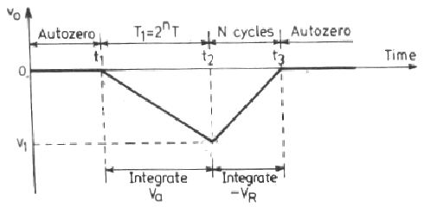
Dual-slope ADC cont…
At the arrival of the START, command at t = t₁, the control logic opens SW₂ and connects SW₁, to V_{a} and enables the counter starting from zero.
The circuit uses an n-stage ripple counter and therefore the counter resets to zero after counting 2^{n} pulses.
The analog voltage V_{a} is integrated for a frxed number 2^{n} counts of clock pulses after which the counter resets to zero.
If the clock period is T, the integration takes place for a time T₁ = 2^{n} x T and the output is a ramp going downwards as shown in Fig.

Slide 5
Dual-slope ADC cont…
The counter resets itself to zero at the end of the interval T₁ and the switch SW₁ is connected to the reference voltage (- V_{R}).
The output voltage v_{o} will now have a positive slope.
As long as v_{o} is negative, the output of the comparator is positive and the control logic allows the clock pulse to be counted.
However, when v_{o} becomes just zero at time t = t₃, the control logic issues an end of conversion (EOC) command and no further clock pulses enter the counter.
It can be shown that the reading of the counter at t₃ is proportional to the analog input voltage V_{a}.

Slide 6
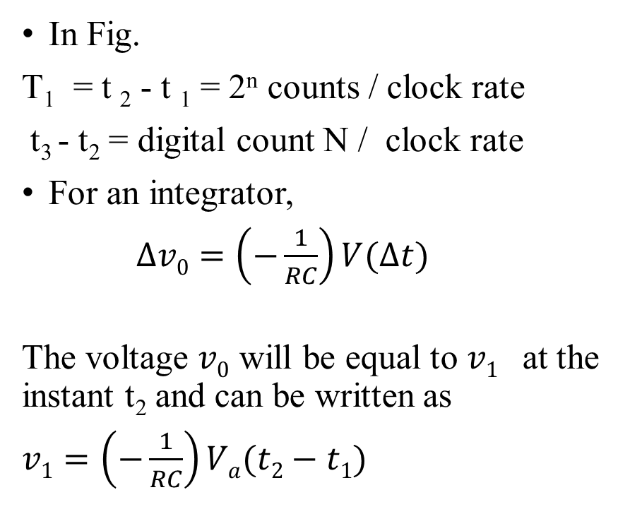
Dual-slope ADC cont…
In Fig.
T₁ = t ₂ - t ₁ = 2^{n} counts / clock rate
t₃ - t₂ = digital count N / clock rate
For an integrator,
$∆v0=\left(−\frac{1}{RC}\right)V(∆t)$
The voltage $v0$ will be equal to $v1$ at the instant t₂ and can be written as
$v1=\left(−\frac{1}{RC}\right)Va(t2−t1)$

Slide 7
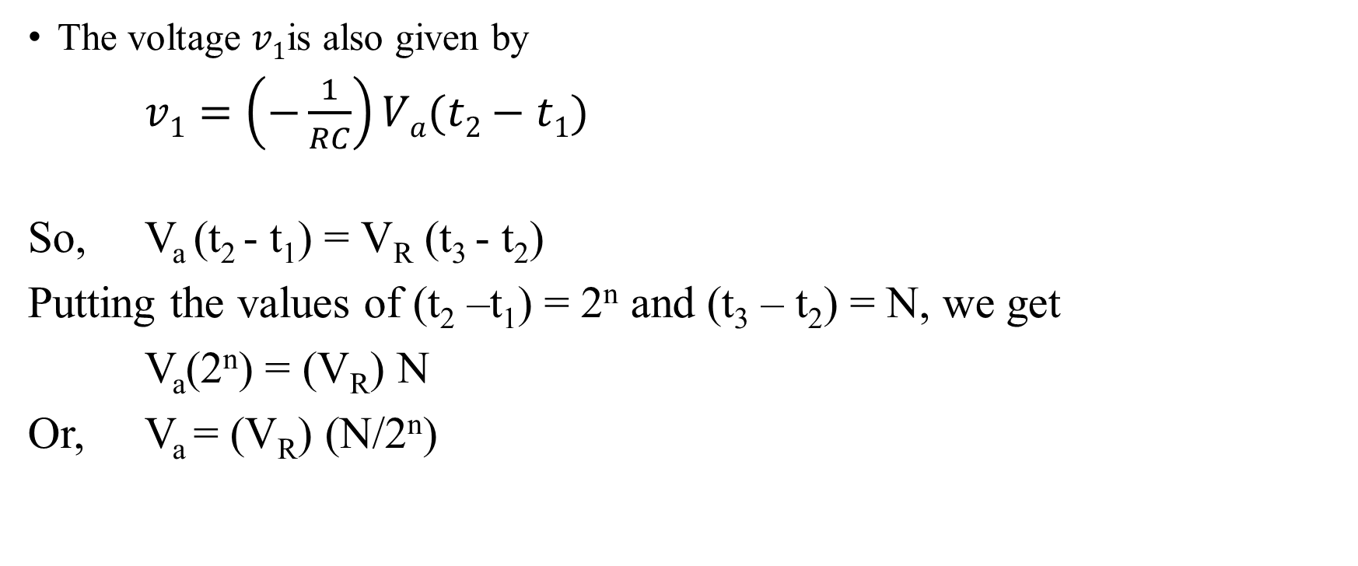
Dual-slope ADC cont…
The voltage $v1$is also given by
$v1=\left(−\frac{1}{RC}\right)Va(t2−t1)$
So, V_{a} (t₂ - t₁) = V_{R} (t₃ - t₂)
Putting the values of (t₂ –t₁) = 2^{n} and (t₃ – t₂) = N, we get
V_{a}(2^{n}) = (V_{R}) N
Or, V_{a} = (V_{R}) (N/2^{n})

Slide 8
Important Observations
Since V_{R} and n are constant, the analog voltage V_{a} is proportional to the count reading N and is independent of R, C and T.
The dual-slope ADC integrates the input signal for a fixed time, hence it provides excellent noise rejection of ac signals whose periods are integral multiples of the integration time T₁. Thus ac noise superimposed on the input signal such as 50 Hz power line pick-up will be averaged during the input integration time. So choose clock period T, so that 2^{n}T is an exact integral mu,ltiple of the line period (1/50) second = 20 ms.
The main disadvantage of the dual-slope ADC is the long conversion time. For instance, if 2^{n} - T = 1/50 is used to reject line pick-up, the conversion time will be 20 ms.

Slide 9
Uses
Dual-slope converters are particularly suitable for accurate measurement of slowly varying signals, such as thermocouples and weighing scales.
Dual-slope ADCs also form the basis of digital panel meters and multimeters.
Dual-slope converters are available in monolithic form and are available both in microprocessor compatible and in display oriented versions. The former provide the digital
code in binary form whereas the display oriented versions present the output code in a format suitable for the direct drive of LED displays.
The Datel Intersil ICL7109 is a monolithic 12-bit dual-slope ADC with microprocessor compatibility.

Slide 10
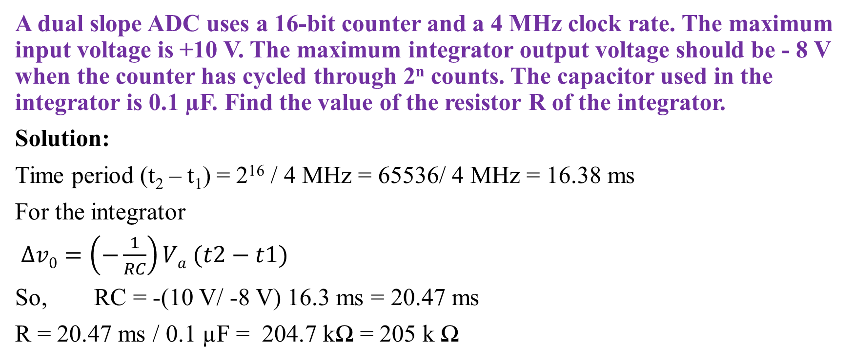
Problems -1
A dual slope ADC uses a 16-bit counter and a 4 MHz clock rate. The maximum input voltage is +10 V. The maximum integrator output voltage should be - 8 V when the counter has cycled through 2^{n} counts. The capacitor used in the integrator is 0.1 µF. Find the value of the resistor R of the integrator.
Solution:
Time period (t₂ – t₁) = 2¹⁶ / 4 MHz = 65536/ 4 MHz = 16.38 ms
For the integrator
$∆v0=\left(−\frac{1}{RC}\right)Va (t2−t1)$
So, RC = -(10 V/ -8 V) 16.3 ms = 20.47 ms
R = 20.47 ms / 0.1 µF = 204.7 kΩ = 205 k Ω

Slide 11
Problems -2
In the previous problem, If the analog signal V_{a} is +4.129 V, 10.4, find the equivalent digital number.
Solution:
Since, V_{a} = V_{R} (N / 2^{n})
So the digital count N = 2^{n} (V_{a} / V_{R}) = 65536 (4.129 V / 8 V) = 33825 for which the binary equivalent is 1000010000100001.

